Slide 1
Your full stack
RNA technology partner
Company presentation
Belgium, June 2025

Slide 2

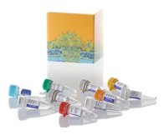






Born in 2021, we aim at powering RNA drugs development through our technology toolbox and close collaboration approach
COVID-19
pandemic announced
DEC 2019
Emergency Use authorization by FDA
DEC 2020
Fiocruz/Bio-Manguinhos embarking on a collaborative partnership, in GMP today!
MICRO-pipetting
MACRO-pipetting
AUGUST 2022
  Traditional scale up through stainless-steel facilities
  No other cost considerations than economies of scale
Launch of the
N-Force toolbox
Creation of
Quantoom Biosciences
JAN 2024
Installation of the 1st Ntensify® midi
JUN 2021
CRADA signed with Afrigen Biologics
MAY 2023
Launch of the
Ntensify® mano
  Used to be considered as the sole ”Large-scale” RNA production techniques
JUN 2022
MAR 2024
2020
2021
2022
2023
2024
2025
Incubation of the
mRNA Tech Project
Launch of R&D Partnerships
SEP 2020
January 2024
Univercells develops breakthrough technologies and services that democratize the production of biologics
+250 people
300 million EUR
PART OF
UNIVERCLLES
SELECTED
PARTNERS
With more than 41 nationalities
In equity and non-dilutive funding

Slide 3
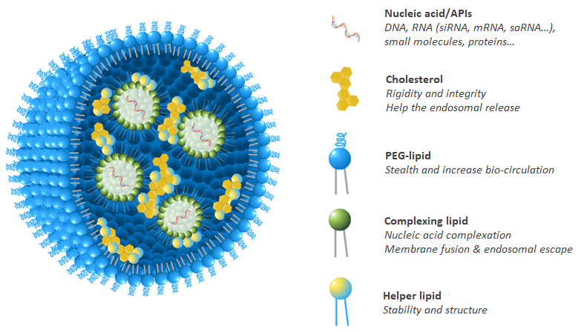
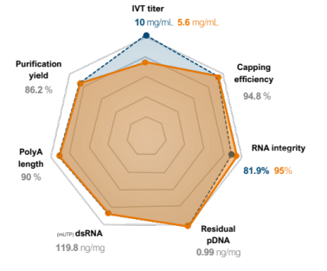
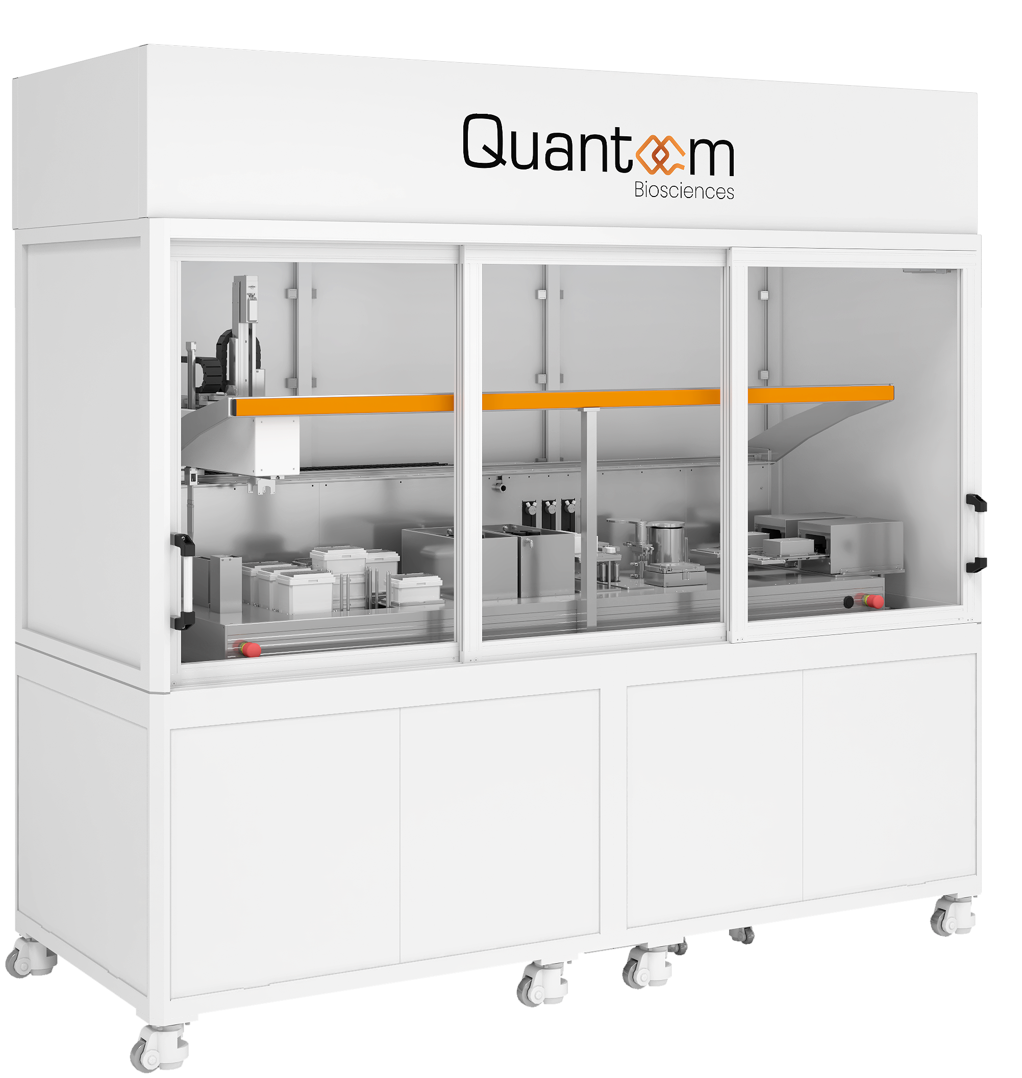
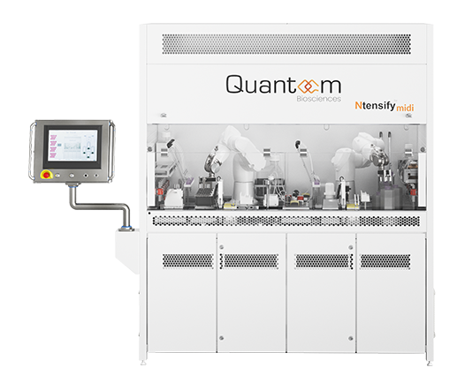


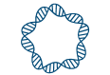
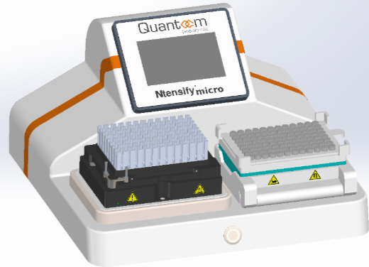
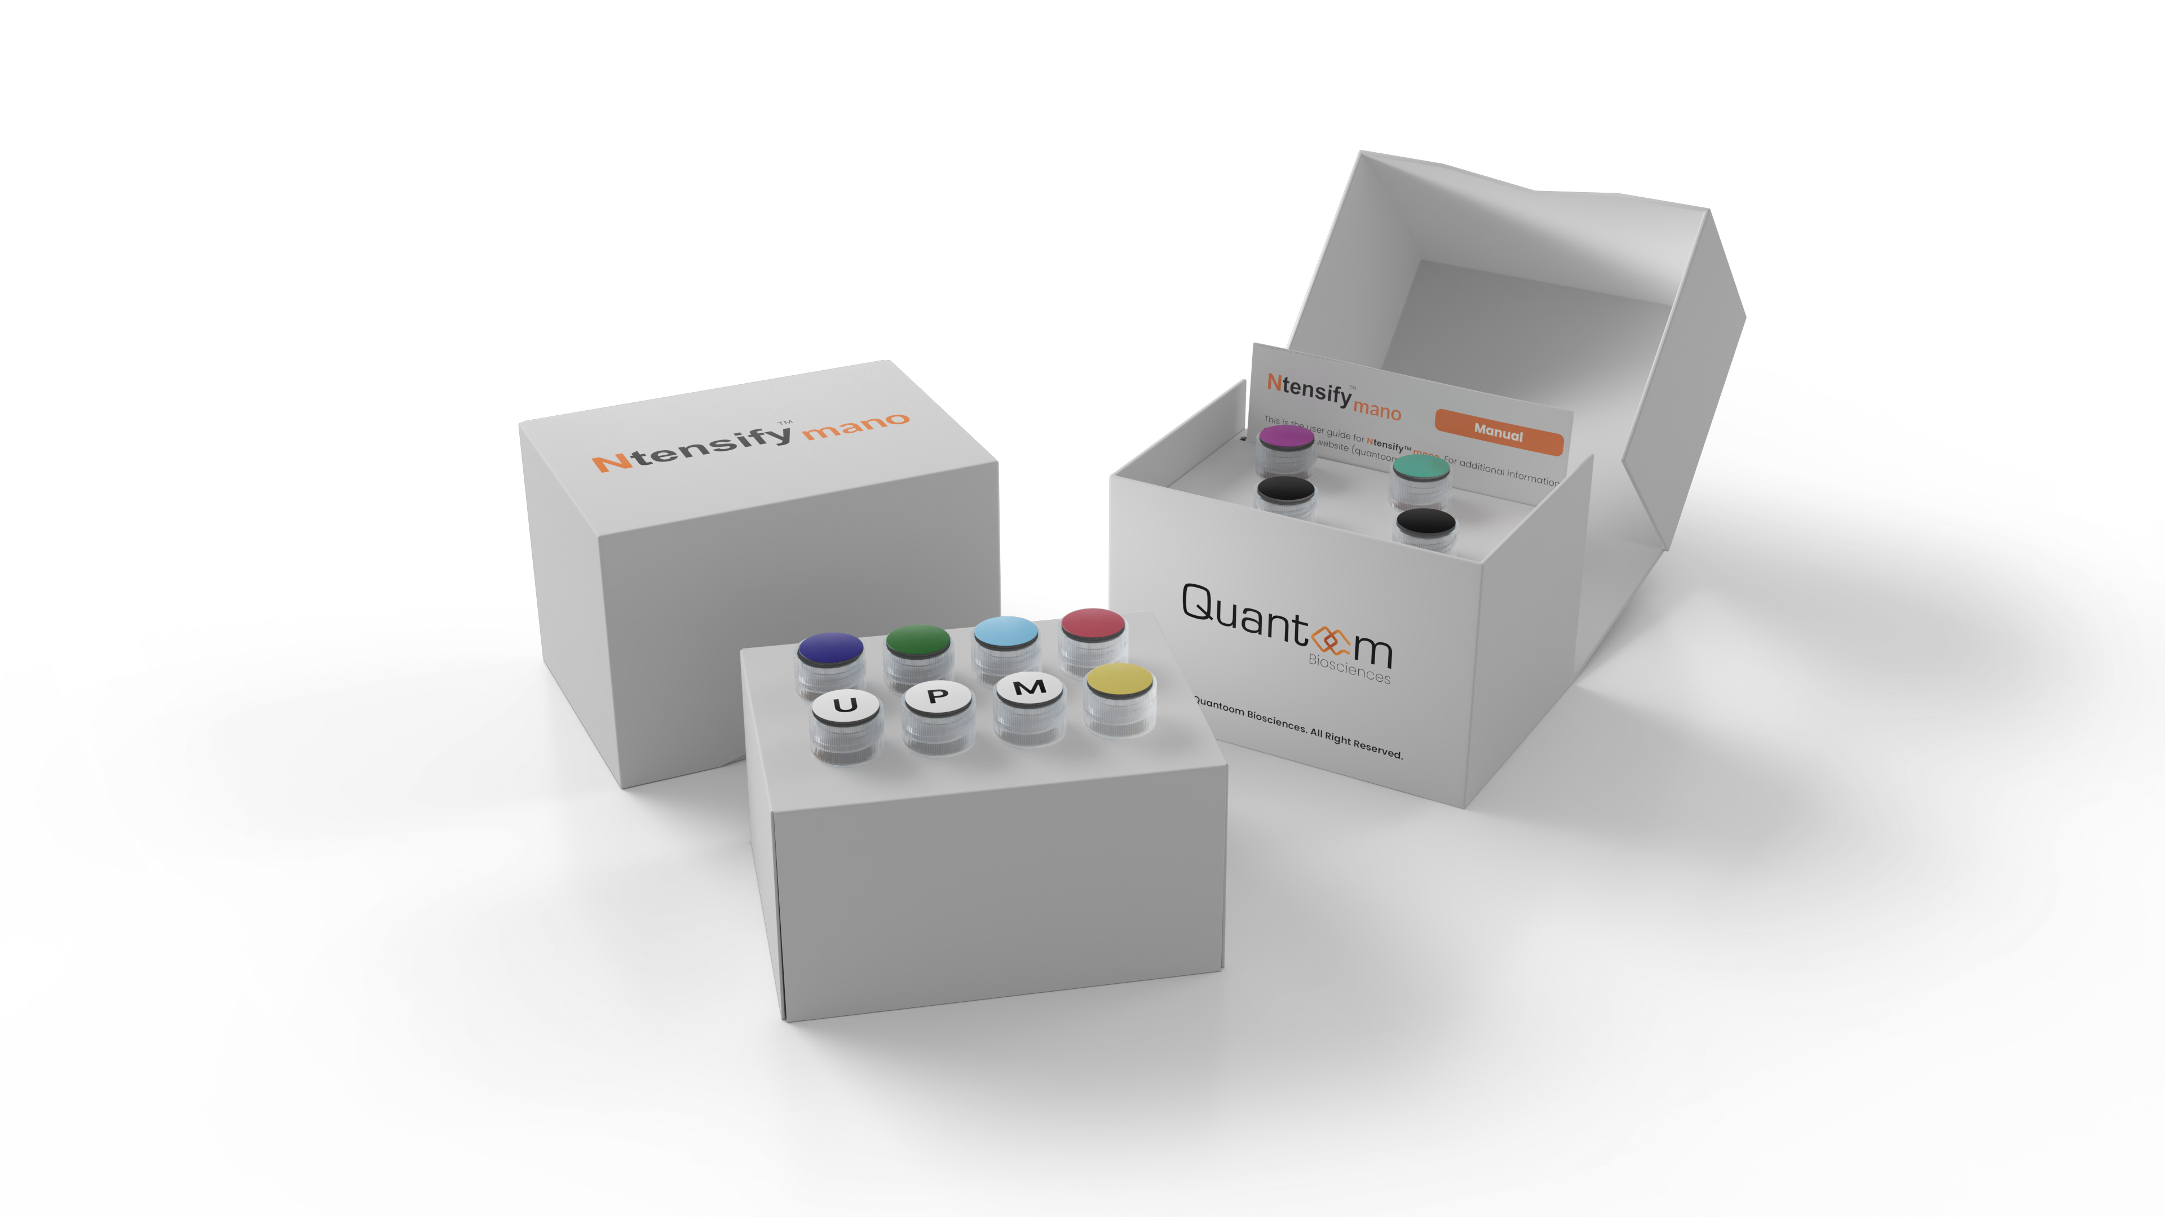
Our unique N-Force toolbox of innovative technologies to fulfill our mission to reinvent mRNA design, production and delivery
We offer an N-Force toolbox composed of end-to-end technologies to accelerate and de-risk RNA drug development
RNA design through bioinformatics platform
RNA production PLATFORM
through redesigned and optimized (sa)mRNA process
RNA delivery through new delivery chemistries and optimized process
A construct-agnostic synthesis & purification PROCESS
Available through MIXES of REAGENTS & equipment
QCX
FTO Lipid-like moleclues for RNA encapsulation with demonstrated functionality in various indications (inf. disease and oncology) in various modalities (saRNA & mRNA)
Select & Rank
Build
Convert
Select the best suited sequence elements
Obtain assembled RNA sequence
Convert into a DNA template
(sa)mRNA design platform, from amino acid sequence to optimally functional (sa)mRNA
A production platform based on an ‘agnostic’ process, providing a standard process and reagent kits for many applications
(Proph. Vx, Cancer therapies…)
FTO formulation chemistries and at the base of (sa)mRNA formulations and process for many applications (Proph. Vx, Cancer therapies…)
Ncode
Ntensify
Ncapsulate

Slide 4
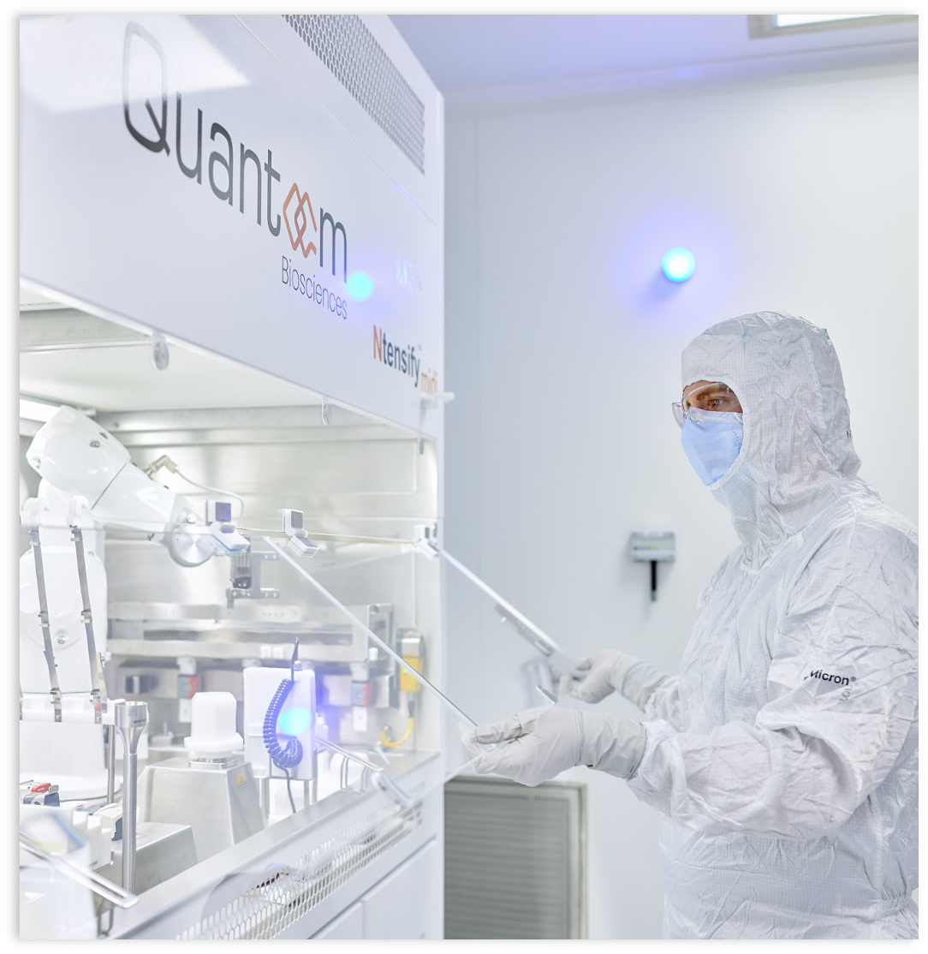
Our N-Force toolbox aims at addressing some of the most critical challenges in RNA vaccine development and manufacturing
Benefits of our solution
1
De-risked: With our construct-agnostic process, there is no more need to re-develop, nor tune the process, for each new RNA construct - our process has been used for +10 (pre-)clinical programs.
2
Fast & Scalable: The combination of our agnostic process with our redesigned scale-out based process enables to save up +15 months of development time - no scale-up needed beyond 20mL
3
Cost-effective: Our re-designed agnostic process, implemented in an automated and intensified equipment, dramatically cuts costs: less CAPEX (low footprint facilities), less OPEX and less development cost
4
Freedom-to-Operate (FTO): Our patented lipid-like Calixarene opens new sustainable possibilities for RNA delivery

Slide 5
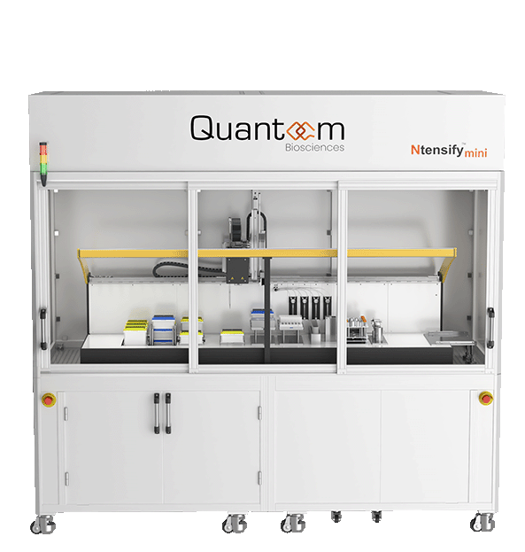
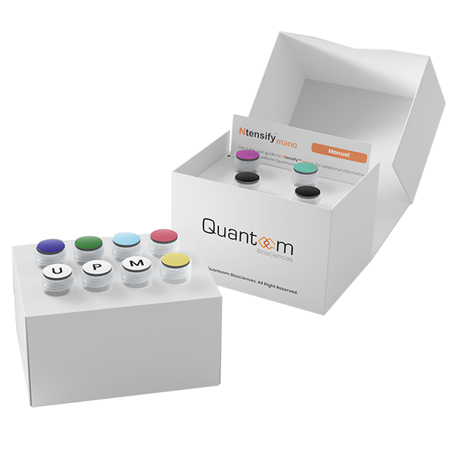
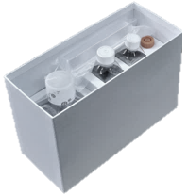
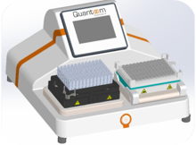

The Ntensify® product line enables seamless scalability from early drug discovery to very large RNA commercial production
Ntensify
R&D enablement
GMP production
Ntensify® mano
Ntensify® R&D Kit
Ntensify® midi
made for
Best partner for automated experiments
24 constructs at 4mg
Pooled to 100mg total
Ntensify® mini
made for
Best partner for process development
96 constructs at 500µg
Same 20mL bioreactor as midi
Manual execution
Ntensify® micro
Clinical trials
& Commercial production
Annual throughput at maxi capacity
mRNA
Up to 3 mg
500µg
96 ≠ constructs
2mg
48 ≠ constructs
100 mg
1 construct
100mg
16 g/batch
saRNA
Up to 6 mg
1mg
96 ≠ constructs
200 mg
1 construct
200 mg
32 g/batch
TIME
3h
3h
1 Day

Slide 6





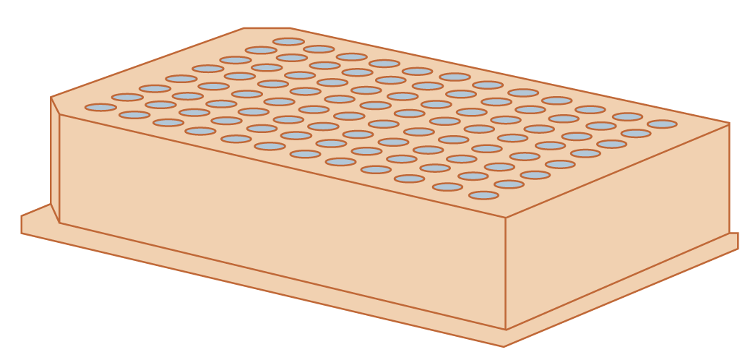



Ntensify
The redesigned process is removing the complex scale-up requirements beyond 20mL
x4
Ntensify®_{micro}
25µL
100µL
20mL
200mL
800mL
3,2L
mRNA
saRNA
250µg
500µg
0.5mg
1mg
100mg
200mg
16g/batch
32g/batch
No SCALE-UP, rather …
… SCALE-OUT
Scale-less disposables
Quantoom has revolutionized the RNA production process to simplify operations and enhances efficiency.
Single-use disposables were specifically designed to enable a scale-out approach with a 20mL IVT cavity.
This allows to increase batch output to the equivalent of a 3,2L IVT with repeated 20mL IVT reactions.
From 20mL
to the equivalent of
3,2L IVT reaction
using a single scale
Reduced CAPEX requirements
Consistent process parameters
No comparability studies
No redundant process mapping
Eased regulatory compliance

Slide 7
Ready-to-use reagent mixes are the materialization of our simplified process leading to reduced development timelines
Ntensify
Ntensify® technology increases process standardisation and minimises risk of human error
UF/DF
USP
DSP
Conventional Process
IVT
Post Transcriptional
DNA Cleavage
Oligo DT
Polish
UF/DF
Ntensify® Process
IVT with
Co-transcriptional Capping
DNA Cleavage
& Quenching
Silica-Based Magnetic Capture
Optimised Concentrations
Optimised Volumes
Optimised pH
Ntensify® Reagent Mixes
Supplied and Ready-to-Use
RNA-pol Enzymes
NTP’s including
Cap analog
IVT
buffers
DNA
removal
Quenchers
Purification Beads
Purification
Buffer
Elution Buffer
Washing Buffer
Sourcing & Mixing Strategy
Qualified Vendors
Robust Manufacturing Process
QA Released
Patented Technology, Know-How and Trade Secrets
Raw materials mixing
Certificates
R&D GRADE
Under LAF in Grade D cleanroom
CoA | TSE BSE | SDS | AOF
GMP GRADE
LAF Grade C Cleanroom In High-Quality Grade facility
CoA | TSE BSE | SDS | AOF | Bioburden | Endotoxins | RNAse
Notes:
Three main messages:
Our process is simpeler then conventional process
We have translated our process in reagent mixes
We have them in two qualities (R&D and GMP)
Securing Supply Chain & Supplier Agreements Allows for negotiation for pricing on reagent supplies, ensuring a stable and cost-effective procurement process
Internalisation of Reagents Reduces reliance on external suppliers by producing some key reagents, decreasing costs, improving control over materials
Increased profitability and enhanced gross margins

Slide 8
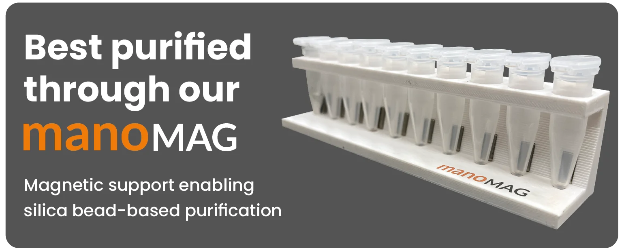

Introducing NtensifyTM Mano
Entry point for RNA construct assessment in vitro & in vivo
Production of up to 3mg (75µg to 3mg)
Includes Uridine (U), Pseudouridine (Ψ) &
methyl-1 Pseudouridine (m1Ψ)
Cap Analog for co-transcriptional capping
DNA template as positive control included
Product Description
R&D : cell-based assays, small screening
In vivo testing : In vivo efficiency
Early pre-clinical trials: dose-escal, tolerance, ...
Applications
VISIT OUR
WEBSITE
Quality : Same quality as your best CDMO provider
Price: High quality at lower prices
Convenience: Easy to use and fast (under 3H)
Key advantages

Slide 9
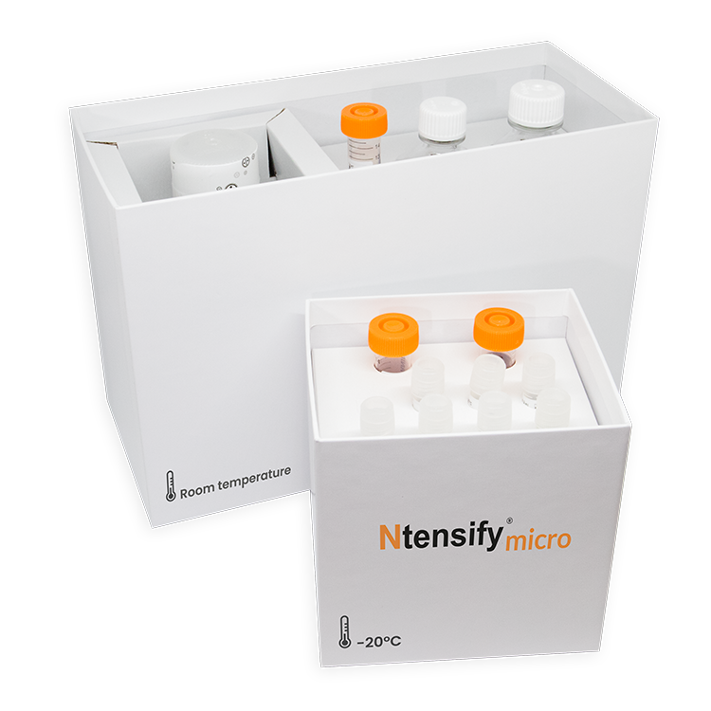
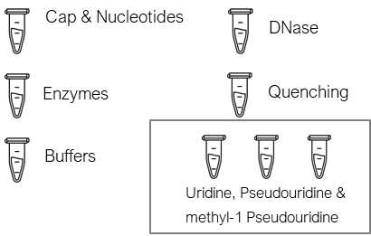

Introducing NtensifyTM micro
High-throughput mRNA screening & small production
NtensifyTM micro is a high-throughput solution designed for the efficient and scalable synthesis of messenger RNA (mRNA) and self amplifying RNA (saRNA). Tailored for both research and pre-clinical applications, this system leverages the NtensifyTM process to deliver a multi well, high yields of high-purity mRNA. Ideal for screening, micro is compatible wiith 96-well plate and 20mL IVT, providing a large amount of flexibility in volume and mixes to scale your experiments according to need.
Description
Production of from 1 well from 96well plate (100µL) up to 20mL
Full flexibility in NTPs and Cap of your option
Purification done within the system
Process protocol included
Product description
Applications
Screening: Screening of mRNA constructs for vaccines, Screening lipid nanoparticles for mRNA delivery, …
R&D / In-vivo: Cell base assays, dose-escal, tolerance, ...
Small production: Protein production, gene therapy applications
Leverages our Ntensify® R&D kits
IVT Reagents
DSP Reagents
Silica Beads
An all-in-one kit containing all mixes of reagents for the Ntensify® process. Good for up to 100mg of mRNA
NF Water
VISIT OUR
WEBSITE
Ethanol
Min 100µL IVT - 500µg RNA
Max 20mL IVT - 100mg RNA
Enabling Affordable Production
of 182 USD/mg*

Slide 10
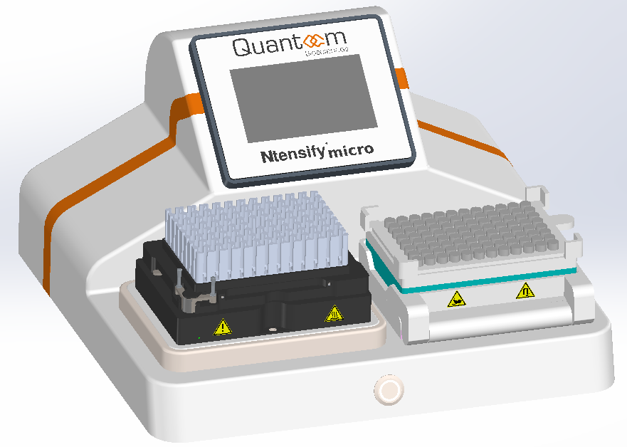
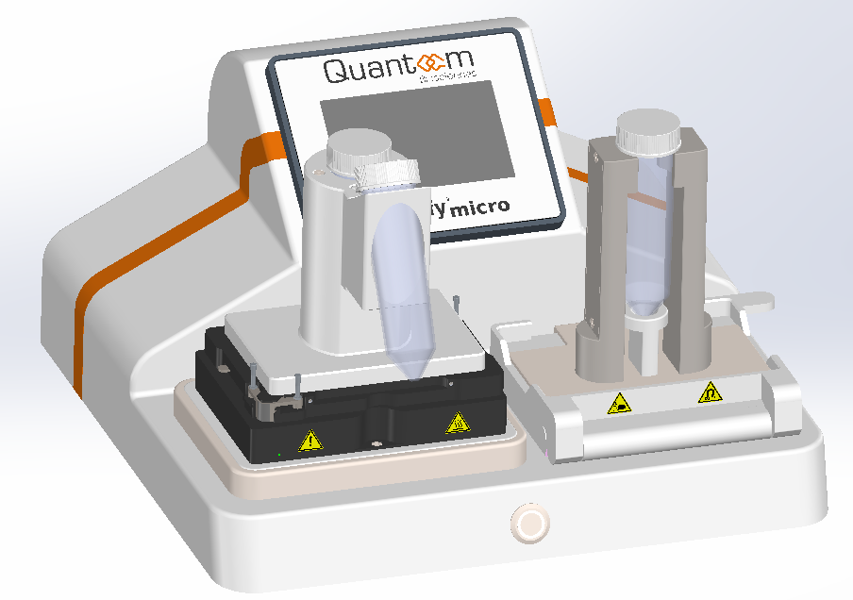
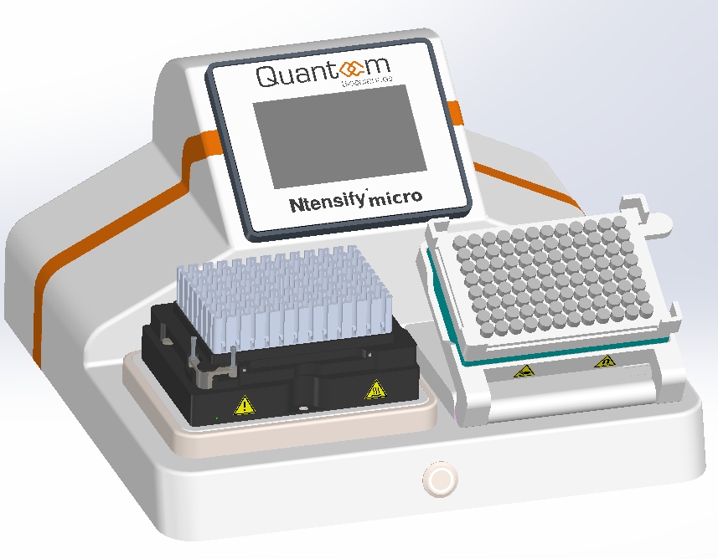
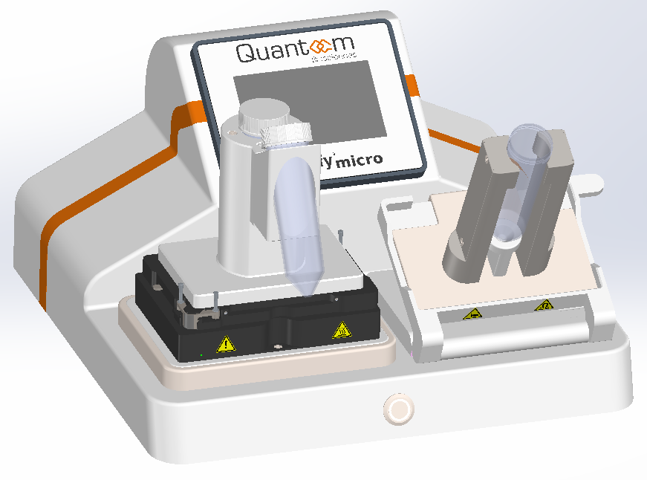
Introducing Ntensify® micro
Equipment Overview: Key Features & Specifications
Ntensify® micro 96 format
Ntensify® micro 50mL tube format
Touch screen
Touch screen
Tiltable container for improved user accessibility
Tiltable container for improved user accessibility
IVT Thermoshaker
DSP Magnet
IVT Thermoshaker
DSP Magnet
Format: 96 well plate
IVT Vol: 100µL/well
Final quantity: 500µg mRNA/well
Rapid process execution 3h
Format: 50mL conical tube
IVT Vol: 20mL
Final quantity: 100mg mRNA
Rapid process execution: 3h
Design subject to slight adjustments following user feedback.

Slide 11
Quantoom is revolutionizing the RNA encapsulation by providing a combined solution: new chemistries & LNP production processes
Ncapsulate QCX - Delivery chemistries
Ncapsulate QCX (Proprietary delivery chemistries)
Quantoom has developed a new class of lipids-like (called QCX) with adaptable heads and interchangeable tails, allowing for customization to achieve specific functionalities.
Our library of proprietary delivery chemistries is free from third-party IP constraints:
In an IP-dense market, our lipid-like molecule unlocks new possibilities for RNA delivery.
We’ve secured protection against third –party IP constraints, with 2 patents.
Our patents are covering both the molecule structure and its possible compositions to cover a wide array of applications.
  A range of distinct lipid structures.
  Optimized ratios of four lipids required to form LNPs, leveraging diverse R1 and R2 configurations.
RNA
(siRNA, mRNA, saRNA, etc.)
Cholesterol
(Rigidity & integrity, help endosomal release)
PEG-lipid
(Stealth & increase bio-circulation)
Helper lipid
(Stability & structure)
QCX
(endosomal escape membrane fusion.)
Breakthrough lipid-like molecule: Novel class of molecule that is not a lipid but shares key structural similarities, while possessing distinct intrinsic properties that set it apart.
Unlocking new possibilities: We have a library of delivery chemistries with demonstrated performances in in-vivo and target species – outperforming gold-standard solution (i.e., commercially available LNPs)
Freedom-to-Operate (FTO): A FTO analysis confirms no IP infringement, ensuring a clear commercialization path
Strong IP protection: 2 patents filed on both the molecule structure and its possible compositions to cover a wide array of applications.

Slide 12
We empower you to unlock the full potential of RNA innovation through diverse collaboration options
N-Force
Our Toolbox of Technologies
Development support
On your R&D projects
Preclinical Candidates
Ready for asset licensing
OUR OFFERING
Ready-to-use processes, equipment & reagents for
RNA Production
LNP Formulation
Delivery chemistries
A team of experts to support your efforts on
Specific RNA design
RNA-drug development
Custom LNP development
2 assets with pre-clinical data and regulatory opinion
Avian Influenza
Rabies
Your benefits
Fast track your way to RNA
From construct to commercial
Tailored RNA’s & LNP’s
Designed in-silico, derisked in-vivo
From concept to clinics
Leverage our assets with pre-clinical data

Slide 13









Quantoom has collaborated with numerous partner to achieve
(pre-)clinical validation of its N-force toolbox
Sequence design & optimization | RNA/formulation preparation | In vitro testing | POC in target species | Early-phase development | Late-stage development | Partner
Animal health
PPRV (mRNA & saRNA)
Avian Influenza, H5N1 (saRNA)
Feline cancer (mRNA)
Feline cancer (mRNA)
Biotechnology
Discovery | Preclinical | Phase I | Phase II/III | Partner
Cancer vaccines
Melanoma (shared antigen, mRNA))
WHAT WE OFFER
Melanoma (neoantigen, mRNA)
To transition towards RNA-based vaccines and therapeutics, we offer tailored R&D partnership opportunities.
Working with partners to going to a first human Phase 1 clinical study as early as Q1-2026
One of the world’s leading cancer hospitals
Melanoma (neoantigen, mRNA)
US Research Center
Colorectal (neoantigen, mRNA)
Prophyl. vaccines
Rabies (mRNA)
Internal program
Covid-19 & Influenza (mRNA)
Avian Influenza, H5N1 (mRNA)
Malaria (mRNA)

Slide 14


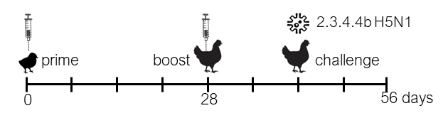
Collaborating with VaxThera to develop an saRNA mosaic vaccine candidate using N-Force and QCX LNP; tested in target
HPAI samRNA with QCX – challenge study in chickens
STUDY OBJECTIVE
Developed an HPAI H5 protein mosaic design incorporating 5,015 sequences from strains spanning 1996 to 2023, with a focus on those circulating between 2021 and 2023
To challenge vaccinated chickens with the currently circulating H5N1 and assess protection of the saRNA-LNP vaccine candidate
Ncode
Ntensify
Ncapsulate
Molecular design of the saRNA constructs
saRNA production and QC with Ntensify® process
Proprietary formulation of saRNA with our
QCX LNP
56-day prime-boost challenge
(7 groups, 10 birds each)
Doses: 0.1, 0.5, and 1 µg
Formulations: Proprietary LNPs & industry reference
Sampling: HI assay, H5 ELISA, cloacal/tracheal shedding
Our team of experts has leveraged N-Force to transform the partner’s provided amino acid sequence into an optimally functional saRNA-based vaccine candidate
Molecular design platform
Ntensify® Production Systems
Ncapsulate® QCX
RNA
(siRNA, mRNA, saRNA, etc.)
Select & Rank
Build
Convert
Select the best suited sequence elements
Obtain assembled RNA sequence
Convert into a DNA template
QCX
PEG-lipid
Cholesterol
Helper lipid

Slide 15
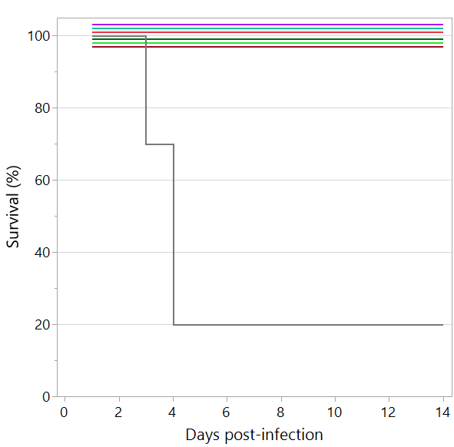
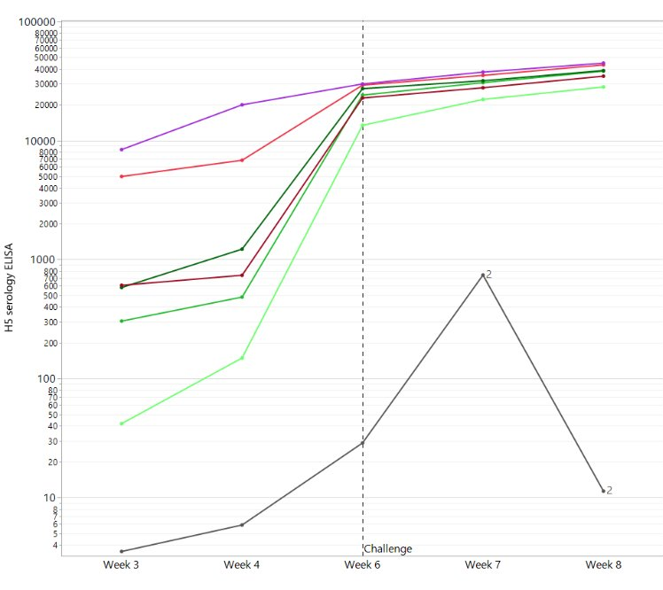
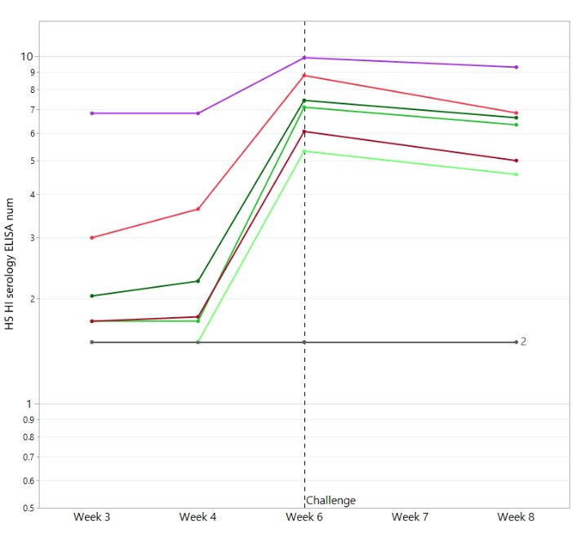


N-Force samRNA vaccines achieve 100% survival and strong antibody response in target species even at lowest dose of 0.1µg
HPAI samRNA with QCX – challenge study in chickens
100% SURVIVAL upon vaccination
ANTIBODY PRODUCTION
H5 antibodies HI antibodies
cx-LNP : Quantoom’s proprietary delivery technology
GS : Golden Standard delivery technology
Vaccinated :
saRNA-QCXLNP 0.1µg
saRNA-QCXLNP 0.5µg
saRNA-QCXLNP 1µg
saRNA-GS 0.5µg
MVA-H5
Inactivated H5N1
saRNA-QCXLNP 0.1µg
saRNA-QCXxLNP 0.5µg
saRNA-QCXLNP 1µg
saRNA-GS 0.5µg
MVA-H5
Inactivated H5N1
Unvaccinated
Unvaccinated
Unvaccinated
Unvaccinated
Unvaccinated
H5 antibodies: following boost injection at week 4, 100% of the vaccinated poultry seroconverted for H5
HI antibodies (neutralizing antibodies): >98% of vaccinated animals seroconverted prior to challenge at week 6
Quantoom’s N-Force toolbox developed a saRNA-based vaccine ensuring 100% survival at day 14 in a high-mortality challenge (p = 0.002). Unvaccinated chickens showed 80% mortality, confirming the challenge’s severity.
Source : internal data

Slide 16
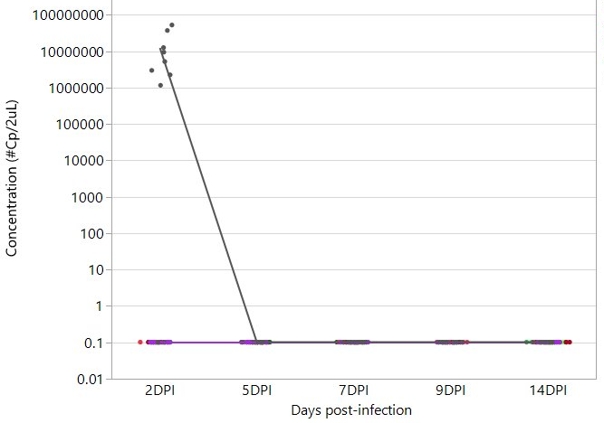
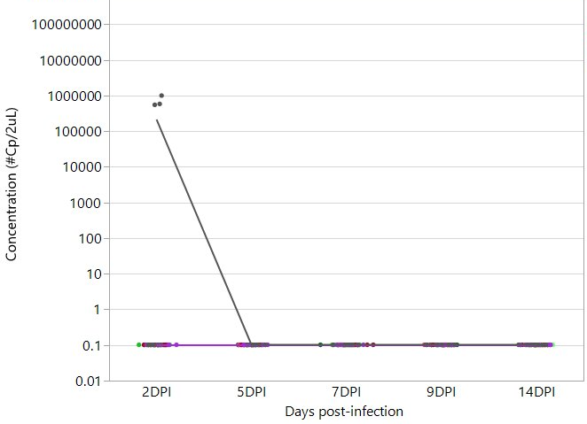
Quantoom’s proprietary QCX delivery technology further prevents virus spread as shown by excretion data
HPAI samRNA with QCX – challenge study in chickens
TRACHEAL SHEDDING
CLOACAL SHEDDING
Unvaccinated
Unvaccinated
saRNA-QCXLNP 0.1µg
saRNA-QCXLNP 0.5µg
saRNA-QCXLNP 1µg
saRNA-GS 0.5µg
MVA-H5
Inactivated H5N1
saRNA-QCXLNP 0.1µg
saRNA-QCXLNP 0.5µg
saRNA-QCXLNP 1µg
saRNA-GS 0.5µg
MVA-H5
Inactivated H5N1
% - 2 days post infection
Of the unvaccinated animals 80% showed tracheal excretion 2 days post infection, compared to no excretion detected by the vaccinated animals.
Of the unvaccinated animals 70% showed cloacal excretion 2 days post infection, compared to no excretion detected by the vaccinated animals.

Slide 17



With a 20g of DP/batch, Quantoom is removing the cost barriers by providing a solution allowing to go as low as 2.5$ for 1,000 doses
HPAI samRNA with QCX – challenge study in chickens
+
Based on total cost of manufacturing and the expected µg of RNA per dose of vaccination, here’s below the envisioned price per dose Quantoom’s technology can achieve:
Cost of manufacturing saRNA solution
Efficient Dose µg saRNA / Dose |  | #doses / batch / day |  | Cost / dose
Flexible drug product production capacity
0.1 µg |  | 100 M |  | 2.5-3$ / 1,000 doses
From 0.1 g/batch
Poultry
From a vision to reality proven by our HPAI program
to
Available for a dedicated session on our Total Cost of Ownership approach and for a tailored model
Cost per dose includes:
DNA supply to a 3rd party
Drug substance production with Ntensify® Midi flex
Drug product production with Ncapsulate®
QC Release testing
20 g/batch
* Ntensify® Midi flex capacity from 20mL to 3.2L IVT volume.
saRNA process at 10g/L of IVT titer, 80% post-DSP recovery. Followed by Ncapsulate formulation with an 80% post-encapsulation recovery.
Based on “in species” results, Quantoom saRNA Nforce seems to be an attractive solution for Animal Health, removing cost barriers associated with RNA vaccines. The total cost of manufacturing by Quantoom’s technology shows price range similar of existing low-cost vaccines.
Notes:
1 batch for 20g = 500k (including midi 3.2l, Ncapsulate, Calixarene, excluding license fee, reagents, disposables)

